Slide 1
Eli Chandler Sprint 001
Apr 12 – Apr 26
Work hard rating 4/5

Slide 2
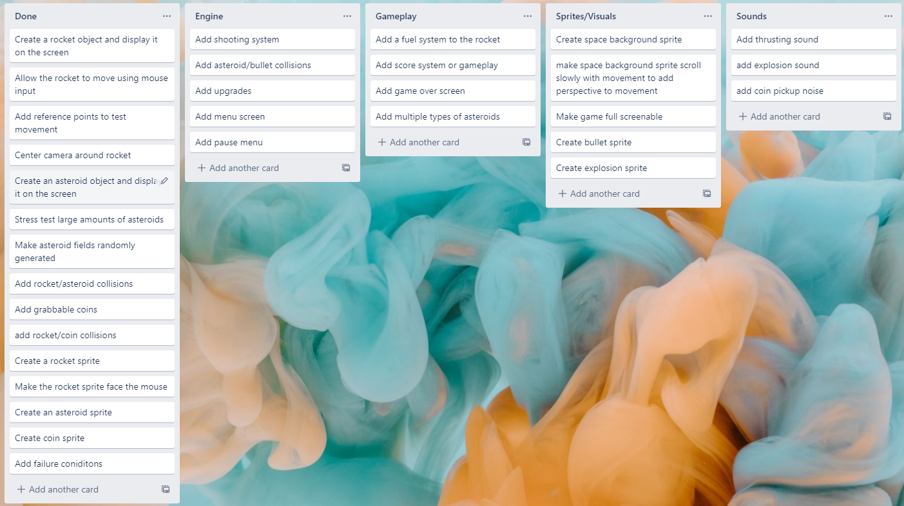
KANBAN Board at the start of the sprint

Slide 3
Sprint reflection and summary
I think that I could have accomplished more during this sprint, but I am still happy with the results as the features I added are very good for improving gameplay and the asteroid optimization made the game a lot smoother
I added a new movement mechanic and added a shooting system, which adds a lot more gameplay and skill cap to the game

Slide 4
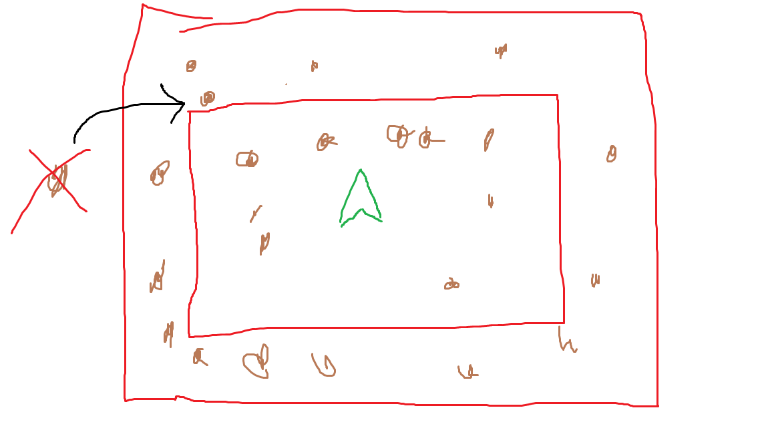
Major changes and achievements
During this sprint I added a shooting system where players can shoot asteroids and make them explode, I also added a fuel system where players have limited fuel, and can only thrust for a certain amount of time before it cuts off. I also added a ‘damper’ system where users can hold right click and the rocket will slow down, the difference between dampers and thrusters is thrusters are directional whereas dampers will always oppose motion. I’m not sure if I will implement this into the actual game as it makes it very easy. I also added a type attribute to the asteroid class so I can in future have more types of asteroids for example coin asteroids or fuel asteroids that refuel the player.
Additionally I got rid of the asteroid chunk system and replaced it with a system where asteroids spawn in an area around the rocket and get despawned when they go outside this area
This diagram gives a rough idea of how it works, the asteroids can spawn within th two red lines, if it goes outside the outer red line it gets deleted and a new asteroid is spawned. The value I used is 100 asteroids, this fills up the game well and provides a constant 60 fps. This system is far more efficient than my old system where I spawned 900 asteroids and most of them weren’t even visible

Slide 5
Brief description of your testing
I tested the shooting system by shooting at asteroids and seeing if they collided properly, I also tried shooting and purposely missing, to test if my system where the bombs will explode after some time worked. I tested the damper system by building up velocity in one direction and than testing if it slowed down on the current axis when I held right click, regardless of mouse position. I tested this for multiple directions to make sure all the math was correct.
I flew around a lot to make sure the asteroid spawning system was working correctly, I found it to be a lot more efficient than the old system because I only had to spawn 1 asteroid at a time instead of up to 300 at once.
This got rid of the stutters when entering what would have been new chunks with the old system, coins still use the chunk system because I want them to be persistent i.e if you pick them up they wont respawn
I also made a fuel bar at the bottom of the screen, it took a couple of attempts to get this lined up correctly, but now its generalized so that it will show the proper fuel % for any total capacity of fuel.

Slide 6
testing
To test my bomb explosion timing I printed the age of the bomb and than when it exploded I printed explode. The age increased accordingly with delta time so I determined that my bombs were exploding after the correct amount of time (3 seconds if nothing was hit)
To test my collisions first I just printed when a collision occurred and what was colliding, than I added an on_hit function to my asteroid class and called it when there was a collison between a bullet and an asteroid. This function killed the asteroid object on collision so the asteroid would disappear when hit.

Slide 7
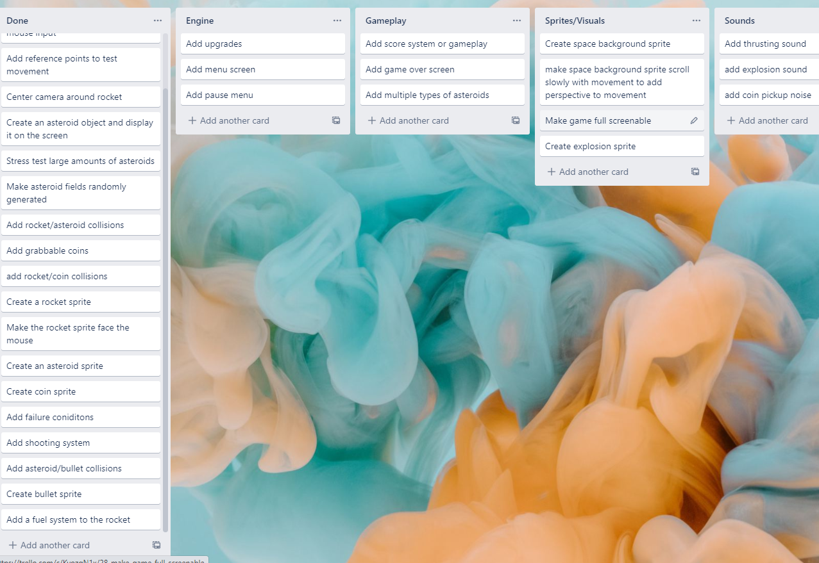
KANBAN Board at end of the sprint

Slide 8
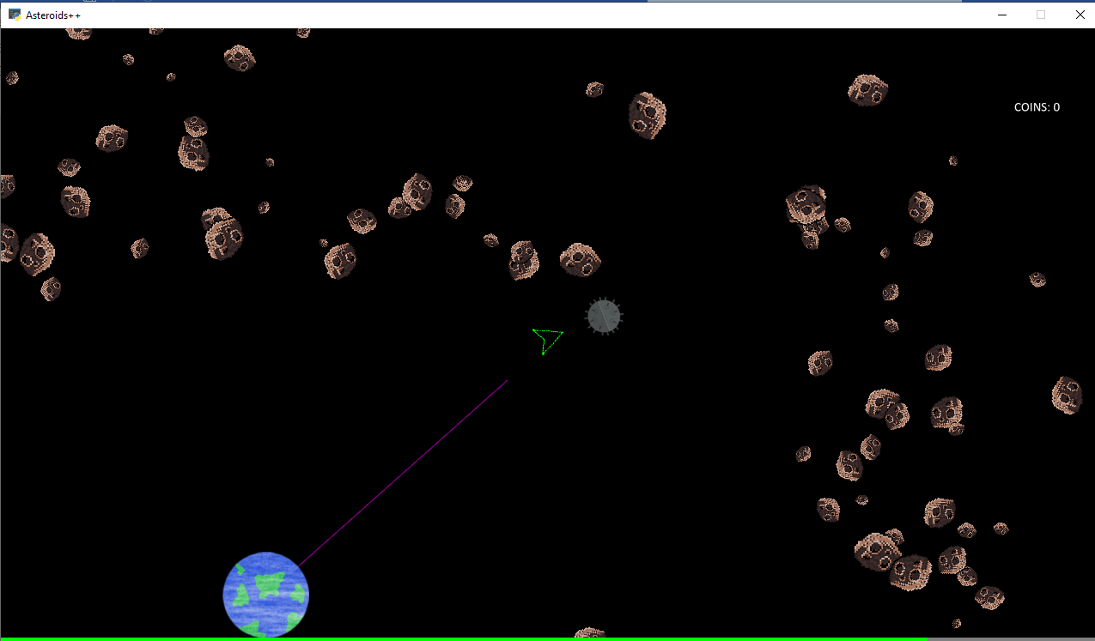
Screenshot of game at the end of the sprint

Slide 9
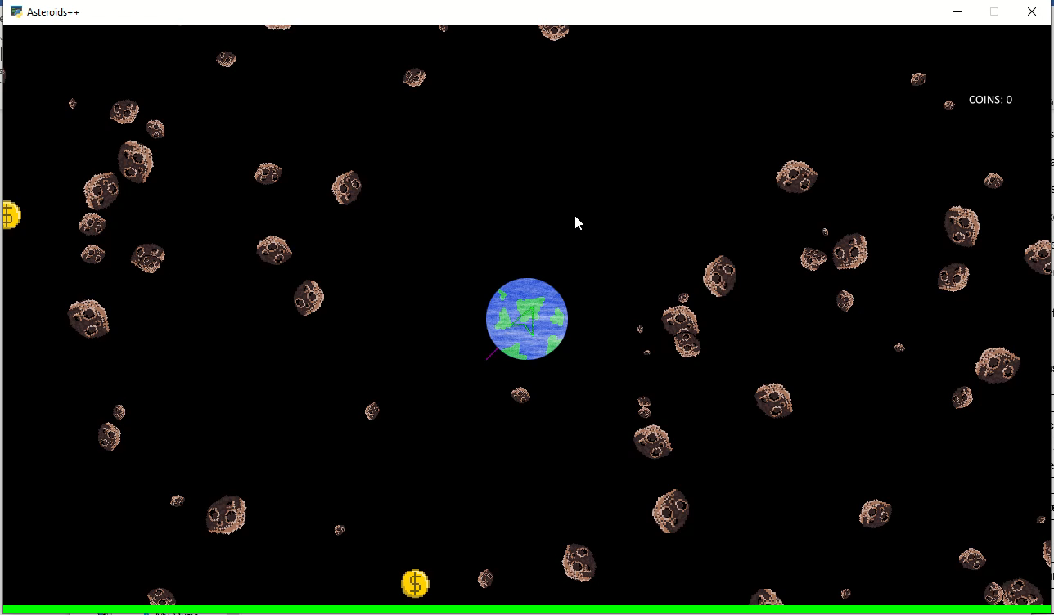
Video of the game at the end of the sprint

Slide 10
Notes for next time, future improvements
I should make an explosion animation when an asteroid is hit or the bomb explodes because right now the bombs feel lifeless and dull. I also want to add a slight amount of recoil to the gun so that

